Slide 1
Configuring for Recoverability

Slide 2
Objectives
After completing this lesson, you should be able to:
  Invoke and configure Recovery Manager (RMAN)
  Configure your database in ARCHIVELOG mode
  Configure multiple archive log file destinations to increase availability
  Configure the Fast Recovery Area (FRA)
  Specify a retention policy
Notes:
Oracle Database 11g: Administration Workshop II 2 - <number>
Objectives
The Fast Recovery Area (FRA) was formerly known as Flash Recovery Area.

Slide 3
Purpose of Backup and Recovery Functionality
Backup and recovery functionality is needed for the following:
  Data protection
    Media failure
    User errors
    Application errors
  Data preservation and historical retention
  Data transfer
Notes:
Oracle Database 11g: Administration Workshop II 2 - <number>
Purpose of Backup and Recovery Functionality
The purpose of backup and recovery is to restore a failed database. Backups protect the database against problems such as hardware failure, media failure, user errors, and application errors. Media errors cause data problems by failing at the hardware level; a bad controller or disk drive can introduce either subtle or obvious errors. Users can also cause data errors, simply by issuing commands that should not be issued. Those same types of errors can be caused by an application with a bug.
Backups can also be used for data preservation and historical retention. Backups taken and preserved in ARCHIVELOG mode can be used to recover a database to a past point in time, which can be useful to meet compliance regulations.
You can also use backup and recovery tools to move data to other databases—even in other locations. A backup of a database is one possible way to duplicate it at another location.

Slide 4
Typical Backup and Recovery Tasks
To be able to recover from data loss problems with minimal down time:
  Configure the database for recoverability
  Define a backup schedule
  Plan and test different types of failure scenarios
  Monitor, tune, and troubleshoot the backup and recovery environment
  Restore data from backups
  Recover transactions to a desired point in time
Notes:
Oracle Database 11g: Administration Workshop II 2 - <number>
Typical Backup and Recovery Tasks
A robust backup and recovery plan is important for a database that you cannot afford to lose. The plan includes the following tasks:
Configuration: A backup and recovery strategy needs to be configured for your environment. This should include backup method, destination for backups, backup retention time and deletion of backups, and backup protection (encryption), if needed.
Scheduling: Backups should be scheduled to run automatically during nonpeak hours.
Testing: Periodically test backups and recovery practices.
Monitoring: Monitor the effects of the backup operations to determine performance degradation on production databases and improve backup efficiency, when necessary.
Restoration: A corrupted data file is overwritten from a backup of the data file. The data file is at a prior point of time than the current database.
Recovery: Recovery applies the changes to the individual blocks, using archive and redo information, to move the database forward to the current point in time.

Slide 5

Oracle Backup and Recovery Solutions
For a recoverable system:
  RMAN
    Block media recovery
    Unused block compression
    Binary compression
    Backup encryption
  Solutions achieved via backup types:
    All data blocks within your chosen files
    (full or incremental level 0)
    Only information that has changed since a previous backup (incremental)
      Cumulative (changes up to last level 0)
      Differential (changes up to last incremental)
Notes:
Oracle Database 11g: Administration Workshop II 2 - <number>
Oracle Backup and Recovery Solutions
The following are major backup and recovery solutions:
Recovery Manager: A utility (with graphic and command-line interfaces) for performing backup and recovery. Some of the major features available when using RMAN are:
Block media recovery: A method of recovering specific blocks of data, as opposed to entire tables (with Data Pump) or data files (with RMAN)
Unused block compression: Unused block compression is a method by which blocks that are not currently used by the database are not read by the backup, and thus, not included in the backup.
Binary compression: A space-saving feature in which backup files are compressed using well-known algorithms (comparable to utilities such as zip on Linux)
Backup encryption: A security device for protecting backups you make
The solutions are achieved with these backup types:
Full backup: Makes a copy of each data block that contains data and that is within the files being backed up
Incremental backup: Makes a copy of all data blocks that have changed since a previous backup. The Oracle database supports two levels of incremental backup (0 and 1). A level 1 incremental backup can be one of two types: cumulative or differential. A cumulative backup backs up all changes since the last level 0 backup. A differential backup backs up all changes since the last incremental backup (which could be either a level 0 or level 1 backup).

Slide 6




Oracle Backup Solutions
OS
RMAN
OSB
Back up as
backup set
Data file 2
Backup
piece
(filesperset 3)
Backup
image
Data file 3
Backup
piece
Backup
image
Data file 4
Backup set
File-system
file
Backup
image
Notes:
Oracle Backup Solutions
The slide shows backup sets. On the left are data files at the OS level. You see how they relate to the RMAN image copies and backup pieces (middle section) and how these relate to the Oracle Secure Backup (OSB) backup images.
At the bottom of the diagram are file-system files, which do not have an RMAN equivalent; they relate directly to OSB backup images.
RMAN backs up data files, control files, redo log archives, and SPFILEs, whether they are the originals, backup sets, or image copies. RMAN performs backup and recovery operations to disk, and with the help of a media management layer (MML) such as Oracle Secure Backup, also to and from tape.
Oracle Secure Backup (OSB) is a centralized tape management software for your entire Oracle environment, including file systems and the Oracle database. OSB can back up and restore data locally or over the local area network (LAN), wide area network (WAN), or SAN.
This diagram shows a subset of the Oracle Backup solution. Not included are image copies and proxy copies, which may be supported by some media managers.

Slide 7
Terminology Review
Match the following terms and descriptions:
  1. ___ backs up a portion of the database. The control file may or may not be included.
  2. ___ is a consistent backup because the SCN in data file headers matches the SCN in the control files.
  3. ___ backs up each data block that contains data and that is within the files being backed up.
  4. ___ is an inconsistent backup because there is no guarantee that the data files are synchronized with the control files.
  5. ___ includes all data files and at least one control file.
(W) Whole database backup (F) Full backup (C) Cold or offline
backup (P) Partial database backup (O) Online backup
Notes:
Terminology Review
Correct Answers: 1P, 2C, 3F, 4O, 5W

Slide 8
Terminology Review
Which description fits best the following backup types:
  1. Image copies
  2. Backup sets
Description:
  A) They are collections of one or more binary files that contain one or more data files, control files, server parameter files, or archived log files. Empty data blocks and currently unused blocks are not stored.
  B) They are duplicates of data or archived log files (similar to a file copy).
Notes:
Oracle Database 11g: Administration Workshop II 2 - <number>
Terminology Review (continued)
Correct Answers: 1B, 2A

Slide 9
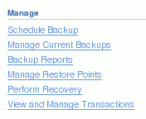
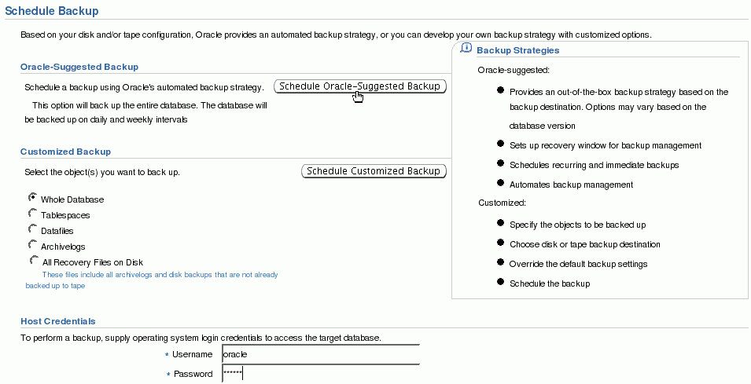
What You Already Know:
Oracle-Suggested Backup
Notes:
What You Already Know: Oracle-Suggested Backup
Enterprise Manager makes it easy for you to set up an Oracle-suggested backup strategy that protects your data and provides efficient recoverability to any point in the preceding 24 hours, and possibly as far back as 48 hours, depending on when the last backup was created. The Oracle-suggested strategy uses the incremental backup and incrementally updated backup features, providing faster recoverability than is possible when applying database changes from the archived log files.
To establish an Oracle-suggested strategy, navigate to the Maintenance page. In the Backup/Recovery region, select Schedule Backup. The Backup Strategies section enables you to select from the Oracle-suggested backup and Customized backup strategies. The Oracle-suggested strategy takes a full database copy as the first backup. Because it is a whole database backup, you might want to consider taking this at a period of least activity. After that, an incremental backup to disk is taken every day. Optionally, a weekly tape backup can be made, which backs up all recovery-related files.
Because these backups on disk are retained, you can always perform a full database recovery or a point-in-time recovery to any time within the past 24 hours, at the minimum. The recovery time could reach back as far as 48 hours. This is because just before a backup is taken on a given day, the backup from the beginning of day n–1 still exists.

Slide 10
Using Recovery Manager
$ rman target /
RMAN> BACKUP DATABASE;
Starting backup at 10-JUN-07
.
.
RMAN> LIST BACKUP;
BS Key Type LV Size Device Type Elapsed Time Completion Time
------- ---- -- ------- ----------- ------------ ---------------
1 Full 1.06G DISK 00:01:49 10-JUN-07
.
.
RMAN> DELETE OBSOLETE;
.
.
Do you really want to delete the above objects (enter YES or NO)? YES
deleted archived log
.
.
Notes:
Oracle Database 11g: Administration Workshop II 2 - <number>
Using Recovery Manager
Invoke RMAN at the operating system command line and specify the appropriate options. The following are the most commonly used options:
target: The connect-string for the target database
catalog: The connect-string for a recovery catalog
nocatalog: Specifies there is no recovery catalog. This is the default.
cmdfile: The name of an input command file
log: The name of the output message log file
The RMAN invocation shown in the slide simply connects to the local database, as the target.
Here is an example of an RMAN invocation that connects to the local database using OS authentication, and specifies a command file to be run and a log file to receive a transcript of the RMAN commands that belong to the session:
$ rman target / cmdfile=~/fullbu.rman log=~/fullbu.log
At the RMAN prompt, you can submit RMAN commands to manage your backup environment and create backups in many different ways, depending on your needs. Shown in the slide are commands to list the existing backups (LIST BACKUP) and delete any obsolete backups (DELETE OBSOLETE). The specifics of what these and other commands do are covered throughout this course.
Note: Refer to the Oracle Database Backup and Recovery User’s Guide for more information about how to invoke RMAN. Refer to the Oracle Database Backup and Recovery Reference for the complete list of RMAN commands and their options.

Slide 11
Types of RMAN Commands
RMAN commands are of the following types:
  Stand-alone command:
    Is executed individually at the RMAN prompt
    Cannot appear as subcommands within RUN
  Job command:
    Must be within the braces of a RUN command
    Is executed as a group
Some commands can be executed as either a stand-alone or a job command.
Notes:
Oracle Database 11g: Administration Workshop II 2 - <number>
Types of RMAN Commands
You can issue two basic types of RMAN commands: stand-alone and job commands.
Stand-alone commands are executed at the RMAN prompt and are generally self-contained. Some of the stand-alone commands are:
CHANGE
CONNECT
CREATE CATALOG, RESYNC CATALOG
CREATE SCRIPT, DELETE SCRIPT, REPLACE SCRIPT
Job commands are usually grouped and executed sequentially inside a command block. If any command within the block fails, RMAN ceases processing; no further commands within the block are executed. The effects of any already executed commands still remain, though; they are not undone in any way.
An example of a command that can be run only as a job command is ALLOCATE CHANNEL. The channel is allocated only for the execution of the job, so it cannot be issued as a stand-alone command. There are some commands that can be issued either at the prompt or within a RUN command block, such as BACKUP DATABASE. If you issue stand-alone commands, RMAN allocates any needed channels by using the automatic channel allocation feature.
You can execute stand-alone and job commands in interactive mode or batch mode.

Slide 12
Job Commands: Example
Job commands appear inside a RUN command block:
RMAN> RUN
2> {
3> ALLOCATE CHANNEL c1 DEVICE TYPE DISK
4> FORMAT "/disk2/%U";
5> BACKUP AS BACKUPSET DATABASE;
6> SQL 'alter system archive log current';
7> }
Execution of the entire block starts
when this line is entered.
Deallocated after the
RUN block completes
Notes:
Oracle Database 11g: Administration Workshop II 2 - <number>
Job Commands: Example
Unlike stand-alone commands, job commands must appear within the braces of a RUN command. Commands placed inside a RUN block as shown in the slide are run as a single unit of commands. Any configurations made within the run block apply within the scope of the block and override any previously made settings. The following are examples of job commands, which must appear inside a RUN block:
ALLOCATE CHANNEL
SWITCH
RMAN executes the job commands inside a RUN command block sequentially. If any command within the block fails, then RMAN ceases processing; no further commands within the block are executed. In effect, the RUN command defines a unit of command execution. When the last command within a RUN block completes, the Oracle database releases any server-side resources such as input/output (I/O) buffers or I/O slave processes allocated within the block.
Note: The SQL command on line 6 is just an example. It is NOT a required command for the backup operation.

Slide 13
Configuring Your Database for Backup and Recovery Operations
  Operate the database in ARCHIVELOG mode.
  Configure the FRA.
Archiver
(ARCn)
Online redo
log files
Archived
redo log files
Archived
redo log files
Control file
backups
Data file backups
Notes:
Oracle Database 11g: Administration Workshop II 2 - <number>
Configuring Your Database for Backup and Recovery Operations
When you operate your database in ARCHIVELOG mode, you have more recovery options after a data loss, including point-in-time recovery of the database or some tablespaces.
It is recommended that you take advantage of the Fast Recovery Area to store as many backup and recovery–related files as possible, including disk backups and archived redo logs.
Some features of Oracle Database backup and recovery, such as Oracle Flashback Database and guaranteed restore points, require the use of a Fast Recovery Area.
Both of the features are covered in detail later in this lesson.

Slide 14

ARCHIVELOG Mode
Archiver
(ARCn)
Online redo
log files
Archived
redo log files
Notes:
Oracle Database 11g: Administration Workshop II 2 - <number>
ARCHIVELOG Mode
As modifications to data in the database are made, the redo data is written out to the online redo log file. A given file is specified as being written to at a given time. When it is full, the Archiver process (ARCn) copies the online log file to another location that serves as an archive of that file, which can be preserved for as long as you need it. This provides more opportunities for recovery, because you can save, back up, and restore all of the archive redo logs ever generated.
Because the online redo log files are reused in a circular fashion, there is a protocol for controlling when one is allowed to be reused. In ARCHIVELOG mode, the database only begins writing to an online redo log file if it has been archived. This ensures that every redo log file has a chance to be archived.

Slide 15
Configuring ARCHIVELOG Mode
To place the database in ARCHIVELOG mode, perform the following steps:
  Using Enterprise Manager
    Select the “ARCHIVELOG Mode” check box.
    Click Apply. The database can be set to ARCHIVELOG mode only from the MOUNT state.
    Click Yes when asked whether you want to restart the database.
  Using SQL commands
    Mount the database.
    Issue the ALTER DATABASE ARCHIVELOG command.
    Open the database.
Notes:
Oracle Database 11g: Administration Workshop II 2 - <number>
Configuring ARCHIVELOG Mode
Placing the database in ARCHIVELOG mode prevents redo logs from being overwritten until they have been archived.
In Enterprise Manager, do this by navigating to Availability > Recovery Settings and selecting the ARCHIVELOG Mode check box. The database must be restarted after making this change.
To issue the SQL command to put the database in ARCHIVELOG mode, the database must be in MOUNT mode. If the database is currently open, you must shut it down cleanly (not abort), and then mount it. The following shows the commands to shut down an open database, put it in ARCHIVELOG mode, and then open it:
SQL> SHUTDOWN IMMEDIATE
SQL> STARTUP MOUNT
SQL> ALTER DATABASE ARCHIVELOG;
SQL> ALTER DATABASE OPEN;
With the database in NOARCHIVELOG mode (the default), recovery is possible only until the time of the last backup. All transactions made after that backup are lost.
In ARCHIVELOG mode, recovery is possible until the time of the last commit. Most production databases are operated in ARCHIVELOG mode.
Note: Back up your database after switching to ARCHIVELOG mode because your database is recoverable only from the first backup taken in that mode.

Slide 16
Configuring Archive Log Destinations
Best practice tip: Create multiple destinations. If you had only one and it would fill up, the database would stop.
  Local and remote destinations:
Online redo
log files
Archived
redo log files
LOG_ARCHIVE_DEST_n
Archived
redo log files
  Local-only destinations:
LOG_ARCHIVE_DEST
LOG_ARCHIVE_DUPLEX_DEST
Online redo
log files
Archived
redo log files
Notes:
Oracle Database 11g: Administration Workshop II 2 - <number>
Configuring Archive Log Destinations
Best practice tip: You should create multiple archive log destinations, because if you had only one destination and it would fill up, then your database would stop.
Local and remote destinations: Specify local and remote destinations by setting the set of LOG_ARCHIVE_DEST_n initialization parameters. There are ten of these, so n can be 1 through 10.
In order to specify a local storage location, supply a local directory name for the value of one of these variables, supplying the "LOCATION=" string. For example, to specify the /disk3/arch directory, set one of these variables as follows:
LOG_ARCHIVE_DEST_1 = 'LOCATION=/disk3/arch‘
If you want to specify a remote location for a standby database, use the SERVICE keyword in the value, as in the following example, where standyby1 is the network service
name for the standby database instance:
LOG_ARCHIVE_DEST_2 = 'SERVICE=standby1'.
Local-only destinations: With the Standard edition of the Oracle database, set the LOG_ARCHIVE_DEST and the LOG_ARCHIVE_DUPLEX_DEST parameters to local disk directories. Thus, you can have up to two archive log file locations. For example:
LOG_ARCHIVE_DEST = '/disk1/arch'
LOG_ARCHIVE_DUPLEX_DEST = '/disk2/arch‘
Where available, Oracle recommends that you use the LOG_ARCHIVE_DEST_n method, because this allows the most flexibility in the type and the number of destinations.

Slide 17


Guaranteeing Archive Log Success
1
3
Online redo
log files
Standby1
2
LOG_ARCHIVE_MIN_SUCCEED_DEST = 2
Notes:
Oracle Database 11g: Administration Workshop II 2 - <number>
Guaranteeing Archive Log Success
If you have specified more than one destination for archive log files, you should specify a minimum number of them that are required to succeed in order for the archive to be considered successful. Do this using the LOG_ARCHIVE_MIN_SUCCEED_DEST initialization parameter. Set it to the number of destinations that must succeed in receiving the archived log file. The online log file is not reused until this number is met.
In the example in the slide, there are three destinations specified: two are local, and one is remote. LOG_ARCHIVE_MIN_SUCCEED_DEST is set to 2, which means as long as at least two of the destinations succeed, the online redo log file can be overwritten. The example shows that destination 1 has failed. That does not stop the database, because two of them succeeded.
You can use this parameter with either of the models described in the previous slide. If you use it with the LOG_ARCHIVE_DEST_n model, then this parameter can have values ranging from 1 through 10. If you use it with the LOG_ARCHIVE_DEST model, then the values can be 1 or 2, because you can specify only two destinations in that case.

Slide 18
Notes:
Oracle Database 11g: Administration Workshop II 2 - <number>
Guaranteeing Archive Log Success (continued)
Specifying MANDATORY and OPTIONAL
When you define a destination, you can specify that it is a mandatory one. Do this by specifying the MANDATORY or OPTIONAL keyword after the location specification. Here is an example:
LOG_ARCHIVE_DEST_1 = 'LOCATION=/disk3/arch MANDATORY'
The default is OPTIONAL.
A mandatory destination is given special consideration. If any mandatory destination fails, then Oracle Database considers the archiving of the log to have not succeeded, and the online redo log file is not allowed to be overwritten. In this case, it ignores the LOG_ARCHIVE_MIN_SUCCEED_DEST parameter.
Any destination specified by LOG_ARCHIVE_DEST is mandatory. Any destination declared by LOG_ARCHIVE_DUPLEX_DEST is optional if LOG_ARCHIVE_MIN_SUCCEED_DEST = 1 and mandatory if LOG_ARCHIVE_MIN_SUCCEED_DEST = 2.

Slide 19
Specifying a Retention Policy
  Retention policy: Describes which backups will be kept and for how long
  Two types of retention policies:
    Recovery window: Establishes a period of time within which point-in-time recovery must be possible
    Redundancy: Establishes a fixed number of backups that must be kept
  Retention policies are mutually exclusive.
Backup
Recovery
window
SYSDATE
Backup 1
Backup 2
SYSDATE
Notes:
Oracle Database 11g: Administration Workshop II 2 - <number>
Specifying a Retention Policy
A retention policy describes which backups will be kept and for how long. You can set the value of the retention policy by using the RMAN CONFIGURE command or Enterprise Manager.
Recovery Window Retention Policy
The best practice is to establish a period of time during which it will be possible to discover logical errors and fix the affected objects by doing a point-in-time recovery to just before the error occurred. This period of time is called the recovery window. This policy is specified in number of days. For each data file, there must always exist at least one backup that satisfies the following condition:
SYSDATE – backup_checkpoint_time >= recovery_window
You can use the following command syntax to configure a recovery window retention policy:
RMAN> CONFIGURE RETENTION POLICY TO RECOVERY WINDOW OF <days> DAYS;
where <days> is the size of the recovery window.
If you are not using a recovery catalog, then you should keep the recovery window time period less than or equal to the value of the control file parameter CONTROL_FILE_RECORD_KEEP_TIME to prevent the record of older backups from being overwritten in the control file. If you are using a recovery catalog, then make sure CONTROL_FILE_RECORD_KEEP_TIME is greater than the time period between catalog resynchronizations. Resynchronizations happen when you:
Create a backup. In this case the synchronization is done implicitly.
Execute the RESYNC CATALOG command

Slide 20
Notes:
Oracle Database 11g: Administration Workshop II 2 - <number>
Specifying a Retention Policy (continued)
Recovery catalogs are covered in more detail in the lesson titled “Using the RMAN Recovery Catalog.”
Redundancy Retention Policy
If you require a certain number of backups to be retained, then you can set the retention policy on the basis of the redundancy option. This option requires that a specified number of backups be cataloged before any backup is identified as obsolete. The default retention policy has a redundancy of 1, which means that only one backup of a file must exist at any given time. A backup is deemed obsolete when a more recent version of the same file has been backed up.
You can use the following command to reconfigure a redundancy retention policy:
RMAN> CONFIGURE RETENTION POLICY TO REDUNDANCY <copies>;
where <copies> is the number of copies that are required for policy satisfaction.
Disabling the Retention Policy
You may want to disable the retention policy totally. If you have a separate system, outside of RMAN, that backs up your disk backups to tape, you may want to do this. If you disable the retention policy, then RMAN never considers a backup obsolete. Because RMAN does not have to decide when to remove a backup from disk (because another utility is managing that), RMAN does not need to be configured for making that decision. In this case, records of each backup are maintained for as long as is specified by the CONTROL_FILE_RECORD_KEEP_TIME initialization parameter. Disable the retention policy by using this command:
RMAN> CONFIGURE RETENTION POLICY TO NONE;
Note: You can specify that a backup is an exception to the retention policy that you have defined. This is called an archival backup, which is covered in the lesson titled “Using RMAN to Create Backups.”

Slide 21
A Recovery Window
Retention Policy: Example
Log 100
Log 200
Log 300
Log 400
Log 500
Backup A
Backup B
Backup C
Now
Backup
Obsolete
Recovery window of 7 days
Backup
Not obsolete
Backup B and archive logs 201 through 500 are required to satisfy this retention policy.
Notes:
Oracle Database 11g: Administration Workshop II 2 - <number>
Specifying a Recovery Window Retention Policy: Example
The retention policy in the slide shows that it requires the ability to recover to any time within the last seven days. Some of the backups and logs are obsolete, because they are not needed to recover to a time within the seven-day window. This retention policy is configured thus:
RMAN> CONFIGURE RETENTION POLICY TO RECOVERY WINDOW OF 7 DAYS;
Given the backups and archived log files available, the only data needed to recover to a point inside the recovery window is Backup B and logs 201 through 500. Note that Backup A is not needed because there is a later backup (B) that is still before the recovery window. Also, Backup C is not sufficient as the only backup to retain because it would not satisfy a need to recover to points in time at the beginning of the recovery window. The last backup that was taken before the beginning of the recovery window, including all logs since that backup, is what is necessary.

Slide 22


Using a Fast Recovery Area
  Permanent items:
    Multiplexed copies of the
    current control file
    Multiplexed copies of online redo logs
  Transient items:
    Archived redo logs
    Data file copies
    Control file copies
    Control file autobackups
    Backup pieces
    Flashback logs
Database
Fast Recovery Area
Notes:
Oracle Database 11g: Administration Workshop II 2 - <number>
Using a Fast Recovery Area
The Fast Recovery Area is a unified storage location for all recovery-related files and activities in an Oracle database. All files that are needed to completely recover a database from a media failure are part of the Fast Recovery Area. The recovery-related files are of two types: permanent and transient. Permanent files are actively being used by the instance. Transient files are needed only in the event of some type of recovery operation.
Permanent Items
Control file: Depending on the setting of several initialization parameters, a copy of the control file is created in the Fast Recovery Area location when you create a new database or control file. For details see the “Semantics” section of the CREATE CONTROLFILE command in the Oracle Database SQL Language Reference.
Multiplexed copies of online redo log files: A mirrored copy from each redo log group can be here. When you create a database, you can specify the location of the online redo log files using the LOGFILE clause. If you do not include that clause, then the locations are set according to the values of the following initialization parameters:
DB_CREATE_ONLINE_LOG_DEST_n: If one or more of these variables is set, then these are the only locations used.
DB_CREATE_FILE_DEST: If this is set, then this is the primary file location.
DB_RECOVERY_FILE_DEST: If this is set, in addition to DB_CREATE_FILE_DEST, then this location is used as the mirror.

Slide 23
Notes:
Oracle Database 11g: Administration Workshop II 2 - <number>
Using a Fast Recovery Area (continued)
For more details on how these variables affect the location of the online redo logs, see the LOGFILE clause of the CREATE DATABASE statement in the Oracle Database SQL Language Reference.
Transient Items
Archived redo log files: When the Fast Recovery Area is configured, LOG_ARCHIVE_DEST_1 is automatically set to the Fast Recovery Area location. The Archiver background process creates archived redo log files in the Fast Recovery Area and in other configured LOG_ARCHIVE_DEST_n locations. If no LOG_ARCHIVE_DEST_n locations are defined, the default location for archived redo log files is in the Fast Recovery Area.
Flashback logs: Flashback logs are generated when Flashback Database is enabled.
Control file autobackups: The default location for control file autobackups created by RMAN and autobackups generated by the Oracle database server is the Fast Recovery Area.
Data file copies: The BACKUP AS COPY command creates image data file copies in the Fast Recovery Area.
RMAN files: The Fast Recovery Area is the default location that is used by RMAN for backups and restoration of the archive log content from tape for a recovery operation.
Note: If you need a good performance for your FRA, consider creating it on its own physical disks and controllers.

Slide 24
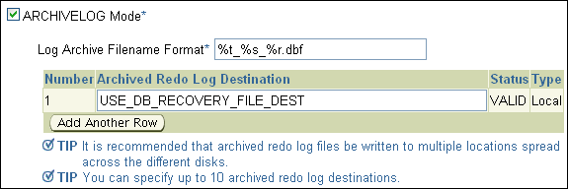
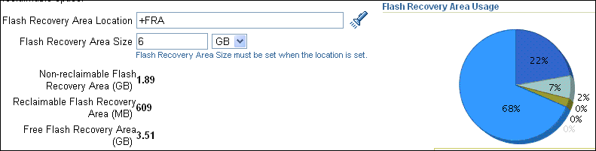
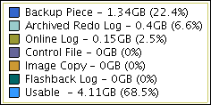
Defining a Fast Recovery Area
The FRA is defined by setting two, dynamic initialization parameters:
  DB_RECOVERY_FILE_DEST_SIZE: Sets the disk limit
  DB_RECOVERY_FILE_DEST: Sets the location for the FRA
Notes:
Oracle Database 11g: Administration Workshop II 2 - <number>
Defining a Fast Recovery Area
Use the following mandatory parameters to define the FRA:
DB_RECOVERY_FILE_DEST_SIZE: You must define a disk limit, which is the amount of space that the FRA is permitted to use. Setting a limit allows the remaining disk space not dedicated to the FRA to be used for other purposes.
A basic recommendation for the size of the disk limit is the sum of the database size, the size of incremental backups, and the size of all archive log files that have not been copied to tape. The reason for this recommendation is that the Oracle-suggested backup strategy takes one image copy of the database (without temp files) and then the incremental backups.
The minimum size of the FRA should be at least large enough to contain archived redo log files that have not been copied to tape.
The sizing of the FRA is dependent on the backup strategy and other options that are implemented. Guaranteed Restore Points also have an effect on the size of the FRA.
DB_RECOVERY_FILE_DEST: An FRA specification contains a location, which is a valid destination to create files.
You can use Enterprise Manager Grid Control and Database Control to easily define the FRA. Navigate to Availability > Recovery Settings. You can define the FRA location and its size on the Recovery Settings page. You must set the size of the FRA when specifying its location.

Slide 25
Fast Recovery Area Space Management
Space limit is reached and a new file needs to be written into the Fast Recovery Area.
Fast Recovery Area
Files that are
no longer
required on
disk are
deleted.
Database file
backup
1
2
3
Space pressure occurs.
4
Warning issued to user
1
RMAN updates
the list of files that
may be deleted.
2
Backup files
to be deleted
Notes:
Oracle Database 11g: Administration Workshop II 2 - <number>
Fast Recovery Area Space Management
Each time RMAN creates a file in the Fast Recovery Area, the list of files that are no longer required on disk is updated. Based on the value of DB_REOVERY_FILE_DEST_SIZE, when the Fast Recovery Area experiences space pressure or is low on free space because there are no files that can be deleted from the Fast Recovery Area, you are warned of the danger of running out of space. The Oracle database server and RMAN continue to create files in the Fast Recovery Area until 100% of the disk limit is reached. When setting DB_RECOVERY_FILE_DEST_SIZE, you must allocate enough space to hold the recovery files, including backups that are waiting to be backed up to tape. Files that are obsolete or have been backed up to tape are likely candidates for deletion to provide free space.
When a file is written into the Fast Recovery Area and space is needed for that file, the Oracle database server deletes a file that is on the obsolete files list. When a file is written and deleted from the Fast Recovery Area, notification is written into the alert log.
Note: When the Fast Recovery Area’s used space is at 85%, a warning alert is issued, and when used space is at 97%, a critical alert is issued. These are internal settings and cannot be changed.
A sample alert log output follows:
WARNING: db_recovery_file_dest_size of 52428800 bytes is 100.00% used, and has 0 remaining bytes available.

Slide 26
Notes:
Fast Recovery Area Space Management (continued)
You can issue the following query to determine the action to take:
SQL> SELECT object_type, message_type, message_level,
2 reason, suggested_action
3 FROM dba_outstanding_alerts;
Your choice is to add additional disk space, back up files to a tertiary device, delete files from the Fast Recovery Area using RMAN, or consider changing the RMAN retention policy.

Slide 27
Fast Recovery Area Space Usage
  Configure the retention policy to the minimum value appropriate for your database.
  Back up the archive log files regularly and delete the files upon completion of the backup.
  Optionally, configure an archive redo log deletion policy.
  Use the RMAN REPORT OBSOLETE and DELETE OBSOLETE commands to remove backups and file copies that are not required.
Notes:
Fast Recovery Area Space Usage
To avoid running out of space in the Fast Recovery Area, perform the following steps as needed or appropriate:
Use RMAN to delete unnecessary files from the Fast Recovery Area.
Use RMAN to take frequent backups of the Fast Recovery Area.
Change the RMAN retention policy to retain backups for a smaller period of time.
Change the RMAN archived log deletion policy.
Add disk space and increase the value of the DB_RECOVERY_FILE_DEST_SIZE database initialization parameter if you frequently run out of space.
Enterprise Manager does not report the amount of space used by the Fast Recovery Area on the disk or the amount of space used in the Fast Recovery Area directory tree, but it does report the sizes of the files that RMAN believes are in the directory. So do not put any files in this area that are not managed by RMAN.
If you remove any file from this area with a tool other than RMAN, use RMAN to remove the file entries from the catalog. For example, to back up the archived log files in the Fast Recovery Area and then delete the files after they have been successfully backed up, you would use the RMAN command as follows:
BACKUP ARCHIVELOG ALL DELETE ALL INPUT;

Slide 28
Notes:
Fast Recovery Area Space Usage (continued)
If you use a backup solution other than RMAN, you still have to use RMAN to remove the files from the Fast Recovery Area. After the archived redo log files have been backed up and removed from disk, use the RMAN CROSSCHECK and DELETE commands to reclaim the archived log space from the Fast Recovery Area. You should do this on a regular basis or after every backup.
You can also use the Manage Backups page of Enterprise Manager to manage backups. On that page, you can perform a cross-check operation and delete expired and obsolete backups.
Configuring an Archived Redo Log Deletion Policy
You can use the CONFIGURE ARCHIVELOG DELETION POLICY command to specify when archived redo logs are eligible for deletion. This deletion policy applies to all archiving destinations, including the FRA.
Archived redo logs can be deleted automatically by the database or as a result of user-initiated RMAN commands:
Only logs in the FRA can be deleted automatically by the database. For archived redo log files in the FRA, the database retains them as long as possible and automatically deletes eligible logs when additional disk space is required.
You can manually delete eligible logs from any location, whether inside or outside the FRA, when you issue BACKUP ... DELETE INPUT or DELETE ARCHIVELOG.
The default is:
CONFIGURE ARCHIVELOG DELETION POLICY TO NONE;

Slide 29


What Is Done Automatically for You
  Simplified archive log management in a multiple-component environment
  Increased availability by failover of backup to optional destinations
Target database
Data files
Image copies
X
Backup pieces
Archive log files
Redundant archive log files
Backup data
Fast Recovery Area
Notes:
What Is Done Automatically for You
Simplified Archive Log Management in a Multiple-Component Environment
This feature simplifies archive log management when used by multiple components, such as Streams. It also increases availability when backing up archive logs, when an archive log in the FRA is missing or inaccessible.
Enhanced Configuration of Deletion Policies
Archived redo logs are eligible for deletion only when not needed by any required components such as Data Guard, Streams, Flashback Database, and so on. When you configure an archived log deletion policy, the configuration applies to all archiving destinations, including the FRA. Both BACKUP ... DELETE INPUT and DELETE... ARCHIVELOG use this configuration, as does the FRA.
When you back up the recovery area, RMAN can fail over to other archived redo log destinations if the archived redo log in the FRA is inaccessible or corrupted.

Slide 30


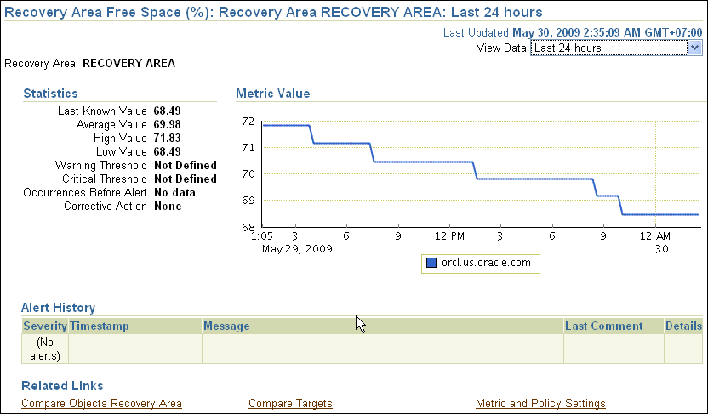

Monitoring the FRA
. . .
Notes:
Monitoring the FRA
Real-time FRA metrics can be viewed through Enterprise Manager Database Control. On the Home page, scroll down to the Related Links section and select All Metrics. Scan the list and click Recovery Area.
The displayed page shows the Recovery Area Free Space (%) metric, which indicates the percentage of the recovery that is free space. Click the percentage number to see the graph of recovery area usage.

Slide 31
Benefits of Using a Fast Recovery Area
Using the Fast Recovery Area for recovery-related files:
  Simplifies the location of database backups
  Automatically manages the disk space allocated for recovery files
Notes:
Oracle Database 11g: Administration Workshop II 2 - <number>
Benefits of Using a Fast Recovery Area
Using a FRA for all recovery-related files simplifies the ongoing administration of your database.
Oracle Corporation recommends the use of the Fast Recovery Area for all recovery-related files.

Slide 32
Quiz
Backup sets can be created for:
  Data files
  Archive logs
  Online logs
  Backup sets
Notes:
Answer: 1, 2, 4

Slide 33
Quiz
Select all statements that are true about the Fast Recovery Area (FRA):
  The FRA can use an ASM disk group.
  The FRA can use an OS directory.
  The FRA can be used by only one database.
  The FRA should be put on your slowest disk to improve recovery.
Notes:
Answer: 1, 2

Slide 34
Summary
In this lesson, you should have learned how to:
  Invoke and configure RMAN
  Configure your database in ARCHIVELOG mode
  Configure multiple archive log file destinations to increase availability
  Configure the Fast Recovery Area
  Specify a retention policy
  Describe the benefits of using the Fast Recovery Area
Notes:
Oracle Database 11g: Administration Workshop II 2 - <number>

Slide 35
Practice 2 Overview:
Configuring for Recoverability
This practice covers the following topics:
  Placing the database in ARCHIVELOG mode
  Verifying that the FRA is configured
  Using RMAN to connect to the target database
Notes:
Oracle Database 11g: Administration Workshop II 2 - <number>

